Slide 1
Overview & kravspec
File with download links for (most of) 21000 pdf files.
Make a script that downloads as many pdfs as possible from the excel fil GRI_2017_2020.
Should be stable and fast.
Saves to a folder on local hard drive.
Creates a new excel file with information about download state of each PDF listed.

Slide 2
Methods & tools
OpenpyXL and yield functions
These two work well to access single rows from an excel file, functionality that pandas lacks.
Urllib with headers for download requests
Already used in the previous script, and has all the functionality needed for the task at hand.
Utilise try-blocks similar to old script
Seems like the most intuitive implementation to both catch errors and only do the necessary downloads.
Concurrent.futures for multithreading
With 21000 files to be (attempted to be) downloaded, multithreading is an obvious solution to the runtime worries in the customer message.

Slide 3
Challenges
Handling download errors; when is a link defective?
Learning multithreading.
Considering (and rejecting) webscraping for PDF’s with defective links.
Worries: time need to learn, accurate searches with limited parameters, wrong files being downloaded.

Slide 4
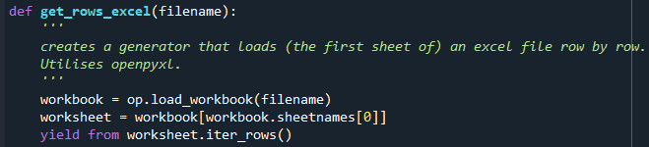
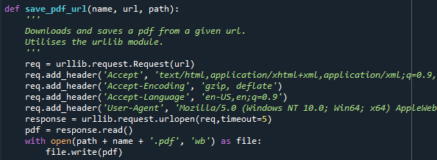
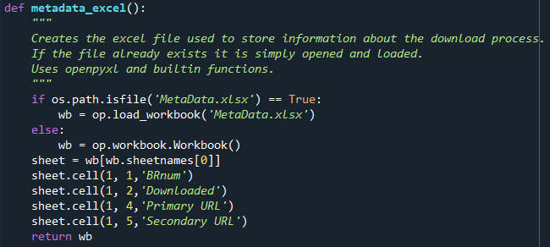
Code examples Helper functions
Generator function using yield and openpyxl to access row in the excel file one at a time, thus limiting memory usage.
Download+save function utilizing urllib. Given an url, a path and a desired name it downloads and saves a pdf file. Headers on the download request increases chances of success as many websites block headerless requests.
Function to load or create metadata file. Checks the working directory for the Excel file ‘MetaData.xlsx’ and either loads or creates it accordingly. Data about download success of each pdf file is later written to this excel file.

Slide 5
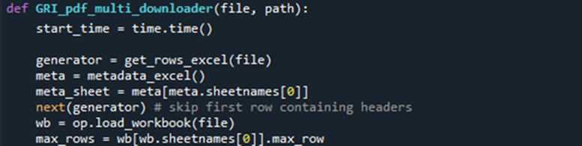
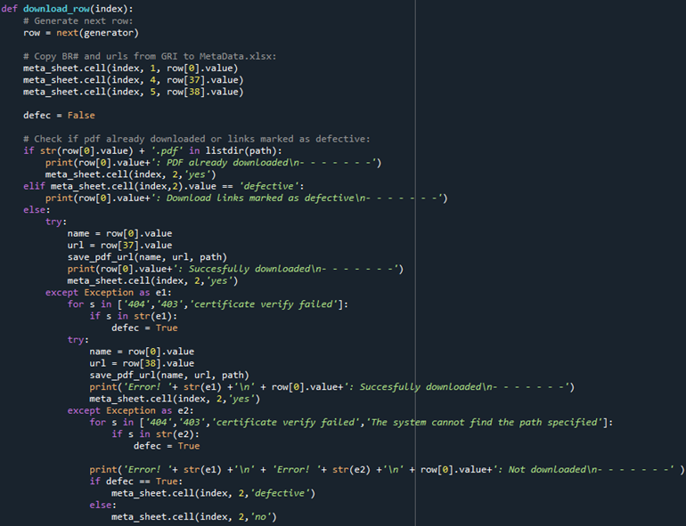
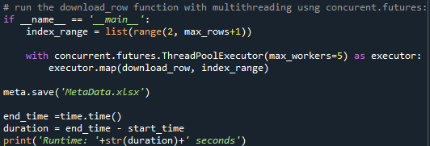
Code examples Main downloader function
Initiates a generator by calling get_rows_excel on the GRI_2017_2020 excel file.
Initiates an openpyxl workbook for the MetaData excel file using the function metadata_excel.
A function is defined for the download loop, utilizing try-blocks. The save_pdf_url function is called on the first download url in the try block. If this fails, the exception block is activated and a second try-block is attempted with a save_pdf_url function call on the second url. If both these fail, an error message is printed, and if the exception message contains certain keywords, the row of the pdf is marked as having defective links in the MetaData excel file.
This function is then called by the concurrent.futures module to use multithreading to speed up the downloading process.

Slide 6
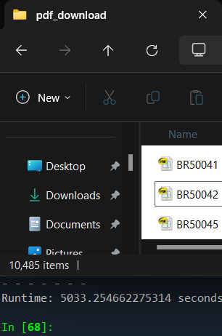
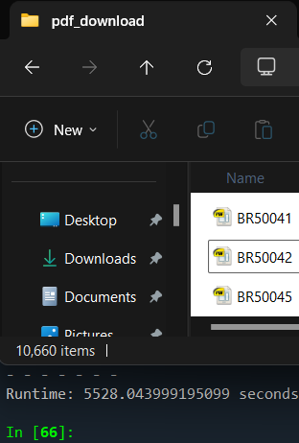
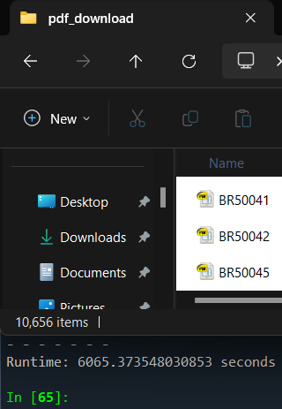
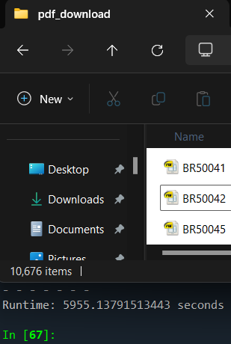
Performance - timeout
2 second timeout:
Runtime 5033.3 seconds = 84 min.
10,485 / 21,057 files downloaded = 49.8% success rate.
5 second timeout:
Runtime 5528,0 seconds = 92 min.
10,660 / 21,057 files downloaded = 50.6% success rate.
10 second timeout:
Runtime 6065.4 second = 101 min.
10,655 / 21,057 files downloaded = 50.6% success rate.
15 second timeout
Runtime 5955.1 seconds = 100 min.
10,676 / 21,057 files downloaded = 50.7% success rate
Timeout seems to have limited effect on success rate.
Max threads = 16 for all.

Slide 7
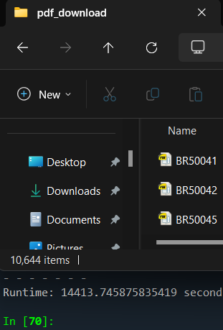
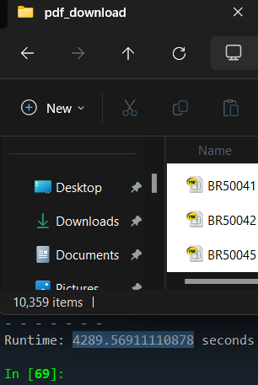
Performance - threads
Max 5 threads:
Runtime 14413.7 seconds = 240 min.
10,644 / 21,057 files downloaded = 50.5% success rate.
Max 16 threads:
Runtime 5528.0 seconds = 92 min.
10,660 / 21,057 files downloaded = 50.6% success rate.
Max 25 threads:
Runtime 4289.6 seconds = 71 min 30 sec.
10,359 / 21,057 files downloaded = 49.2% success rate.
Timeout = 5s for all.

Slide 8
To Do:
Check for corrupted files
Some of the downloaded PDF files cannot be opened and should be discarded to get a better overview of downloaded files.
More user accessibility
Input options for timeout & number of threads

